Slide 2

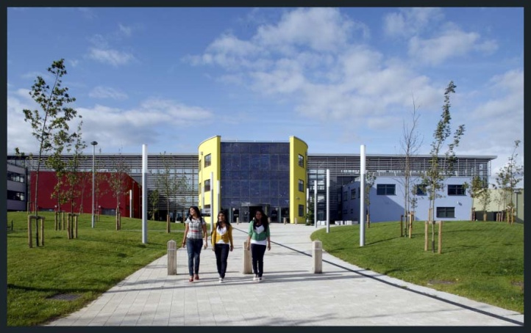
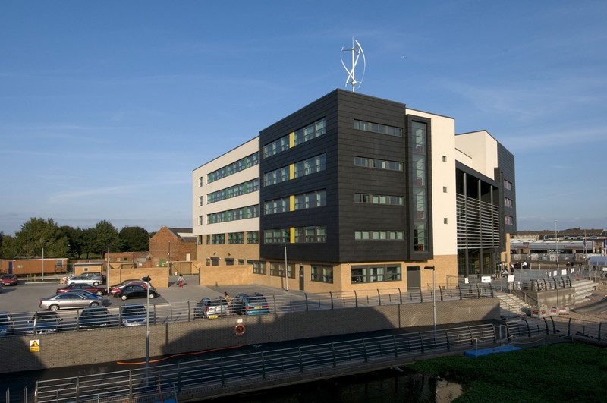

Post 16 Options

Slide 3


During WOW, what did you demonstrate?
Independence
Punctuality
Professionalism
Maturity
An ability to communicate with employers
Presentation of self
Responsibility
CV writing skills
Interview practice
Motivation
Setting aspirations
The ability to speak with confidence
Since WOW,
You have started your PS@16 college application process.
You have begun your personal statement
You have researched Post 16 courses
You are beginning to think about your mock interview

Slide 4

Post 16 Options Evening
Tuesday 5th October 2021
5.45pm – 8pm
Soar Valley College

Slide 5
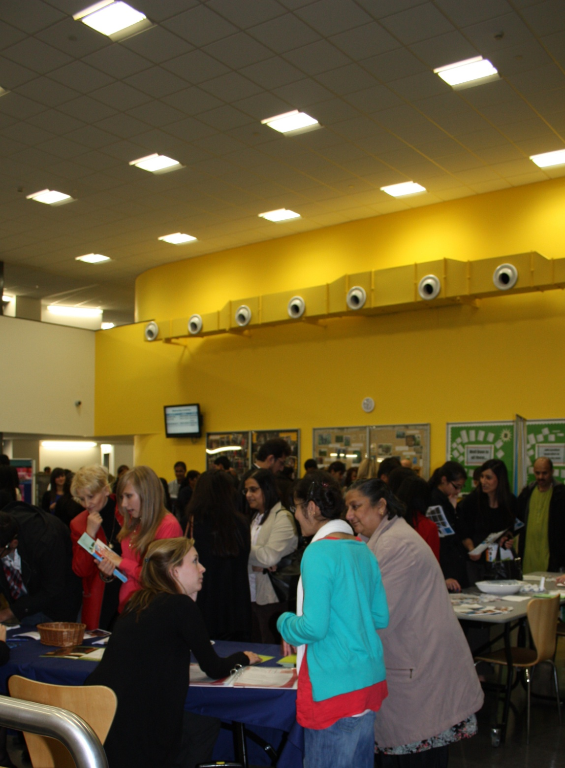
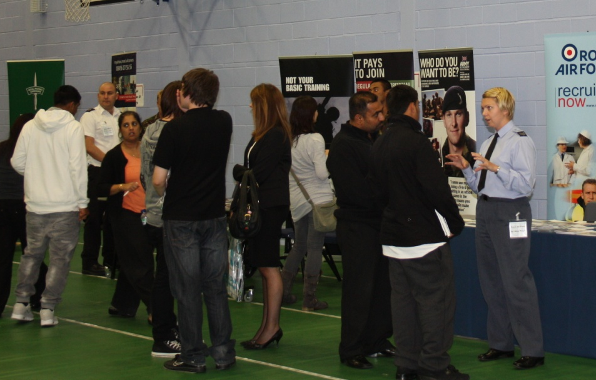
Post 16 Options Evening
This is an event held at Soar Valley College, to help you make choices about your future.
Over the course of the evening, there will be the opportunity to meet and talk to providers of Post 16 education in Leicestershire. There will also be representatives from local universities, various careers and apprenticeship providers.

Slide 6
Post 16 Providers attending this year:
Ask Project
Beauchamp City 6th Form
Beauchamp College
SMB Group College
British Army
Connexions Leicester City
Department of Work and Pensions
De Montfort University
Heart of England Training
Leicester College
Leicester College Apprenticeships
LEBC
Loughborough University
Nth Warwickshire & Sth Leicestershire College
Royal Air Force
University of Leicester
University of Nottingham
WQE College
Gateway College
Juniper Training
Loughborough College
National Space Academy
NCS (National Citizen Service)
Police
The City of Leicester College

Slide 7

How to make the right choice, for you!
What kind of person are YOU? What are YOU good at? What do YOU enjoy? What do YOU want to do after SVC?

Slide 8




What are your priorities?
What can't you do without?
A friendly atmosphere
Being close to home
Good social facilities
Good sports facilities
Being able to continue studying the subjects I enjoy
Being able to study something new
Being able to take a mix of different qualifications
Learning in one place
Spending part of my time in the workplace
Doing a course at a specialist college

Slide 9
What Level do you
need to aim for?

Slide 10
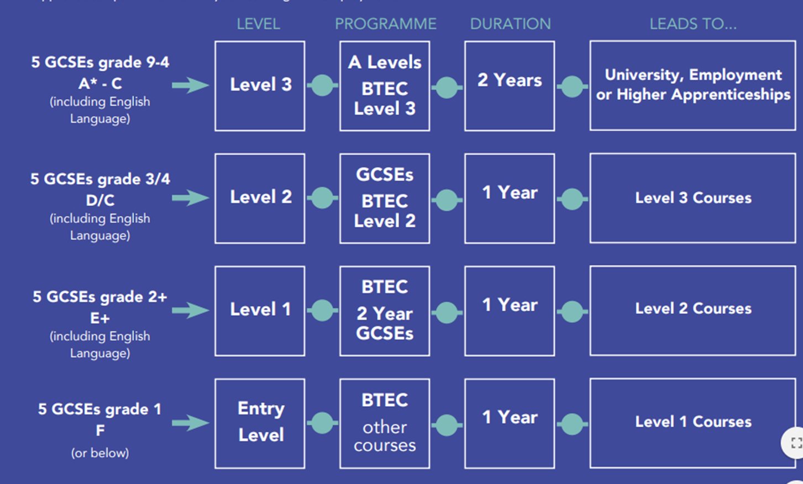






POST 16 ENTRY LEVELS

Slide 11

Planning your career
Finding a rewarding career takes a little planning.
There’s always room to change your mind, but having a plan and having a goal will help you to focus on where you want to end up.
Set yourself goals; short term and long term. They will help you to keep on track. What can you do to shape your future?
Having goals, dreams and aspirations to work towards will mean you are more likely to end up doing a job that is right for you.

Slide 12

What can you do to find out more?
Talk to the careers advisors
Look at Information and Guidance websites (National Career Service, KUDOS, PS@16)
Talk to the people that know you well – Parents, friends, form tutors, subject teachers)
Go to college open days
Attend Post 16 options Evening at Soar Valley College on Tuesday 5th October 2021.

Slide 13



WHAT HAPPENS NEXT?...
Tutor Period – Post 16 research and PS@16 log ins Thursday 16th September Period 1
AM REG input - Apprenticeships information Wednesday 29th September 8.50-9am
Assembly - Post 16 updates and Post 16 Evening Friday 1st October
Post 16 Evening – Meet with Post 16 Providers Tuesday 5th October 5.45-8pm
Mock Interview – Rearranged from WOW Wednesday 13th and Thursday 14th October
Half Term - Monday 18th – Friday 22nd October
Tutor Period – PS@16 deadline Friday 19th November Period 1

Slide 14

Post 16 Options Evening
Tuesday 5th October
5.45pm – 8pm

