Slide 1

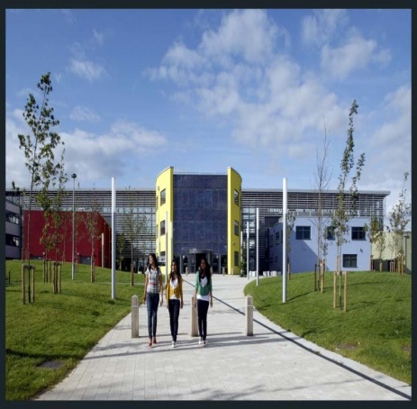
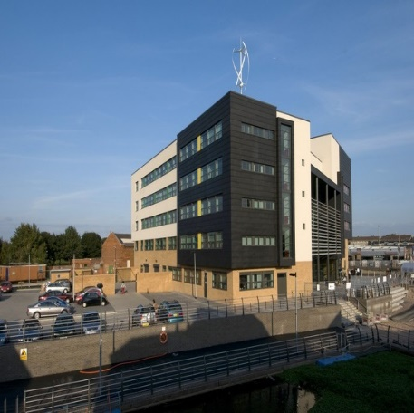
Post 16 Options Evening
An evening designed for students to help them make informed decisions about their future.

Slide 2
Welcome & Introduction
Mr Pabari – Associate Principal
Entry Requirements & Qualifications
UCAS Progress (Application Process)
Miss Houlton – Careers Leader
________________________________
5.45pm – 8.00pm
Talk to Further Education & Training Providers
If you require any further information please contact
Miss C Houlton or Mrs S Patel

Slide 3

Soar Valley College
Qualifications &
Entry Requirements

Slide 4
What are the options?
Post 16 Options for Education and Training
A levels are level 3 qualifications. You can study A levels at sixth form or college. They are available in lots of different subjects such as Business, Drama, History and French. Most A levels are split into units and take two years to complete. Some colleges may still offer AS levels in some subjects.
Vocational Qualifications are Entry Level, Level 1, Level 2 and Level 3 qualifications. These are BTEC Awards, Diplomas & Certificates. VRQs are work related and are designed to give you the skills that employers are looking for. They are available in many different subjects including animal care, art and design and accounting.
GCSEs are level 1 and level 2 qualifications (Gateway, Regent & Leicester College) GCSEs are usually completed in Years 10 and 11 at school. They are nationally recognised qualifications. GCSE’s are only available in English & Maths.
Apprenticeships are available at level 2 and Advanced Apprenticeships are available at level 3. Apprenticeships offer you the opportunity to earn while you learn. They involve both on and off-the-job training. As well as working for an employer, you’ll spend some time at a college or with a training provider.
NVQs are level 1, 2 and 3 qualifications. NVQ stands for National Vocational Qualification. NVQs are recognised qualifications that prepare you for, or prove your ability to do a particular job, such as motor vehicle repairer or customer services assistant.
Functional Skills are Entry Level, level 1 and level 2 qualifications. Functional Skills qualifications are a way of brushing up on your English, maths and ICT skills. They can be completed as part of a Diploma, an Apprenticeship or a Foundation Learning programme. They allow you to bring your English, maths and ICT skills up to level 2.
T Levels – A new type of vocational course which is 80% work place and 20% college based. Courses started from September 2020. Courses available are in Construction, Design, Digital, Education and Childcare, Health & Science. More courses are being added every year. Sept 2022 will see accounting, engineering, finance.

Slide 5
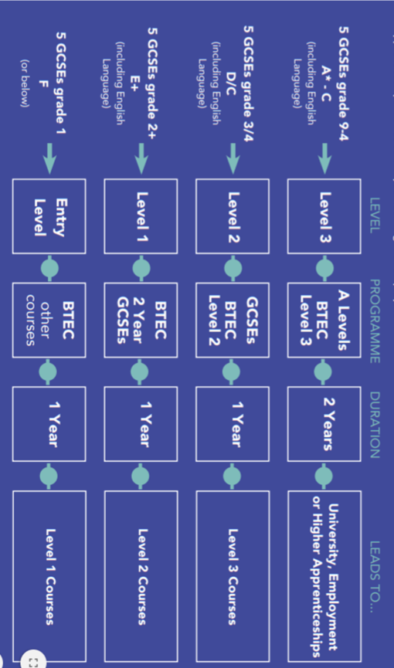
5/6 GCSEs at 9-4 (usually inc English & Maths level 4/5 = Will enable you to access a Level 3 course.
Level 5 is a good pass
GCSEs at 1-3 = Level 1
Entry requirements will vary according to college and chosen course.

Slide 6

What is it?
Positive Steps @16 is an online platform for students to search for and make college applications.
All Year 11 students MUST complete this form to ensure they have options available to them when you leave Soar Valley College.
PS@16can be used to apply for all post 16 learning opportunities in Leicester and Leicestershire. This includes:
6th form colleges
Schools with 6th forms
Further Education (FE) colleges
Apprenticeships and advanced apprenticeships
Foundation Learning

Slide 7
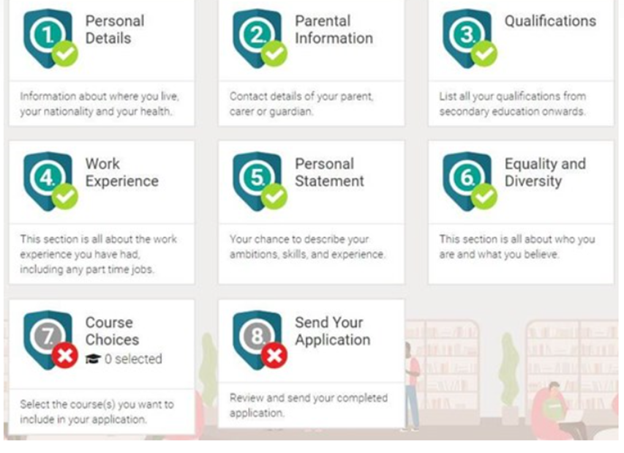
Student Profile on PS@16
2. Parental Information
This is required as students are still children. Students will have inputted contact details for yourselves.
3. Qualifications
This will be completed for students after Year 11 PC1.
Please note that Year 11 PC1 information is what goes to the college.
Personal Details
The college has entered this for your child.
4. Work Experience
An opportunity for students to talk about any work experience they may have.
5. Personal Statement
This is a crucial part of your child’s college application. Students must continue working on this in their spare time and / or at after school support sessions.
Resources are available in student resources to support them.
6. Equality and Diversity
A tick box section which to provide required information to the colleges.

Slide 8
Positive Steps @16
Who can access the system?
Students & Parents
Careers Adviser
Mrs Patel
Form Tutors
Inclusion Staff and SENDCO
Student data
Careers Leader
Miss Houlton
PS@16 Administrator
Mrs Patel

Slide 9
What Level do students
need to aim for?
This is about ensuring you are applying for the right level course. This will depend on your predicted grades.
It is your PC1 information that goes on your college applications.
To summarise,
If you are working at 5 GCSEs at Grade 9 – 4, you are working at Level 2. The course that you need to apply for needs to be a Level 3 course.
If you are working at 5 GCSEs at Grade 3 -4, you are working at Level 1. The course that you need to apply for needs to be a Level 2 course.

Slide 10

Positive Steps @16
(Application Process)

Slide 11
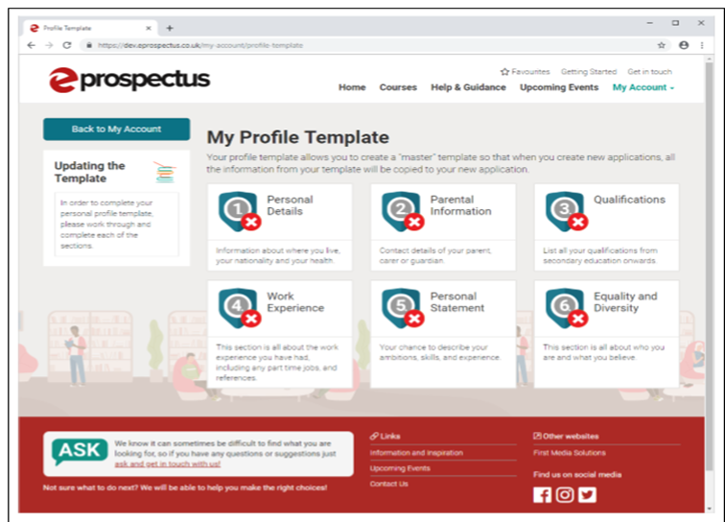

An online database for students to search for and apply for Post 16 courses.
Students have a log in and all have logged in.
Progress will be shown by sections turning green
Students will enter predicted grades from PC1.
Notes:
Stickers in planners
Students will have change to change password. Write it on sticker.

Slide 12








Apprenticeships
Apply for an apprenticeship through a college on PS@16, you should be prepared to be actively searching for your own employer to qualify for a place. Due to a high demand of apprenticeship placements, students must also select a college course as a plan B.
Register with https://www.gov.uk/apprenticeships-guide - select an area of choice and vacancies will be sent directly to you.

Slide 13
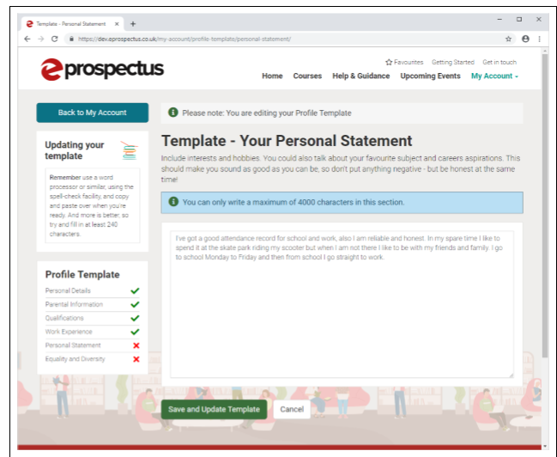
Personal Statement
A personal statement is a crucial part of the college application.
An opportunity for students to sell themselves.
Resources available on student resources.
Student Resources / Careers / KS4 / Year 11 / Personal Statement 2021

Slide 14

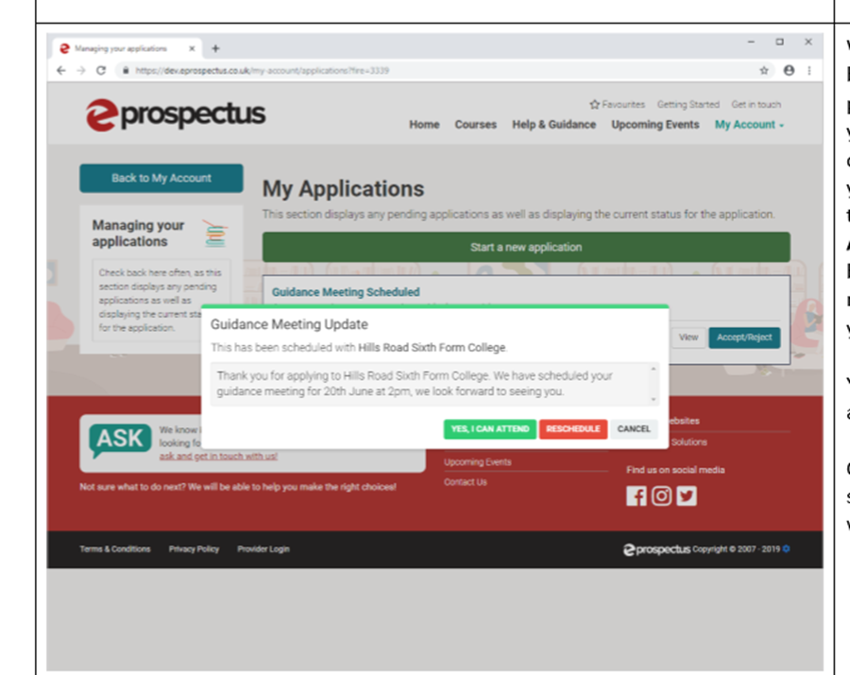
Deadline –
Friday November 19th 2021
After the deadline, tutors will write their references.
Soar Valley College will then send applications off.
Colleges will be in touch to invite students to interview.
Notes:
When your application has been processed by the provider and they schedule your guidance meeting or choose to send you an offer, you can accept or reject it in this screen. Click on the Accept/Reject or Your Offer button to view the meeting/offer and make your choice.
You can press cancel if you are not ready to reply yet.
Once accepted/rejected, the status of your application will change

Slide 15
Tutor’s references
Minimum 96%
Attendance
Attitude to work
Independent study
Aptitude for further study
Effectiveness in group work
Ability to meet deadlines
Self-motivation
Self-confidence
Communication skills
Relationship with staff
Relationship with peers
Overall Impression:

Slide 16
Preparation
Investigate and identify suitable courses and colleges /
6th forms. Look at course entry requirements carefully.
Encourage students to speak to a Careers Advisor, form tutors and subject teachers in the area of interest.
Look at predicted grades and decide what courses are suitable. (A Level, BTEC, Apprenticeships etc). Be realistic about choices.
Look at college prospectuses or useful websites
Visit Colleges during their open days and ask questions.
Use the Soar Valley College website

Slide 17



School website

Slide 18
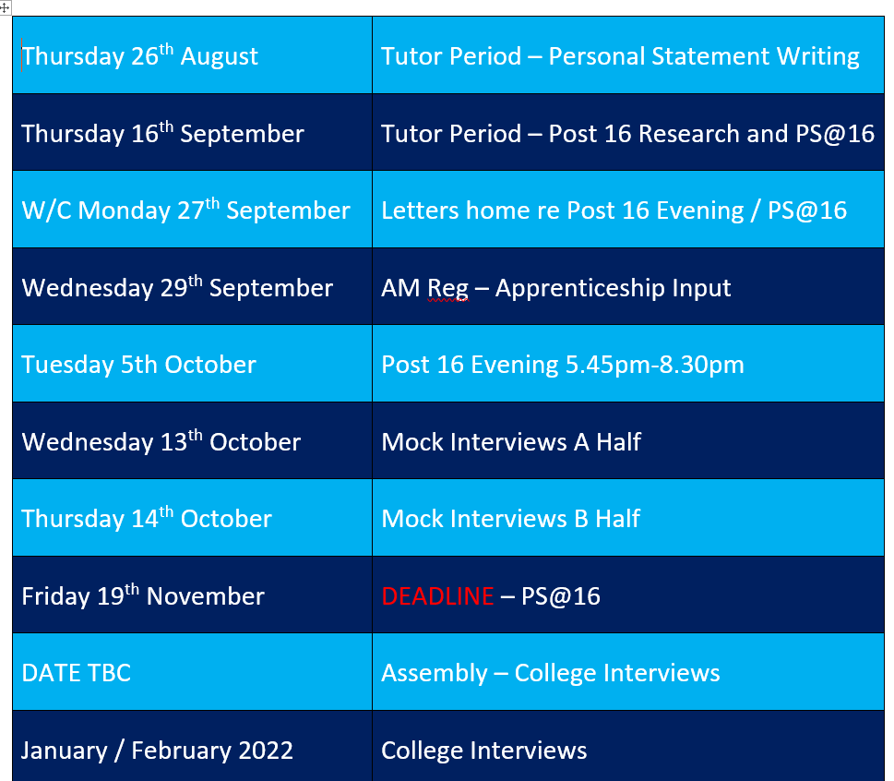
Year 11Key dates
Date | Deadline / Event
Friday 20th September | Post 16 Evening assembly
Monday 23rd September | Post 16 letters go home
Wednesday 25th September | Post 16 replies brought into school
Monday 30th September | Have you prepared useful questions for Post 16 evening? How will you get the most out of the evening? Good questions will be rewarded ☺
October onwards | Start to attend College Open Days to ensure that your personal statement includes informed reasons for your college choices.
Tuesday 1st October | Assembly – Positive Steps 16 (PS@16) Tutor Period – Period 1 PS@16 log ins given out
Wednesday 9th October | Post 16 Options Evening @SVC
Thursday 10th October | What have you learnt from Post 16? Which providers did you feel motivated by? What are you thinking about your courses and why?
Monday 14th October – Friday 18th October | HALF TERM Prepare your personal statement with considered choices for college applications.
Monday 21st October | First draft of personal statement completed. Get tutor to check.
Wednesday 30th October | Period 1 Tutor Period PC1 information given out to students and tutors. Continue with PS@16 applications (searching courses and adding to favourites). Update personal statement accordingly.
DEADLINE Friday 1st November | Personal Statement must be completed and uploaded on PS@16 form.
DEADLINE Friday 8th November | Deadline for entering PC1 qualifications onto PS@16
DEADLINE: Friday 22nd November | Tutor Period – Period 1 PS@16 deadline
Jan - April 2020 | College Interviews Please ensure progress files are up-to-date
Notes:
These should be displayed on form notice boards.

Slide 19
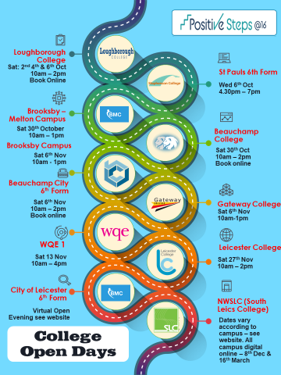

Slide 20





Local colleges
Use the following websites to help with your research.
https://leicestercollege.ac.uk/
https://www.wqe.ac.uk/
https://www.brooksbymelton.ac.uk/
https://www.gateway.ac.uk/
https://www.loucoll.ac.uk/
http://www.cityleicester.co.uk/

Slide 21
Useful websites
www.ps16.co.uk the online data base for searching for and applying for Post 16 options.
www.startprofile.com using log ins from last TP – Here labour market information can be found. Students can click on “world of work” tab to research availability in each industry.
https://kudos.cascaid.co.uk Enter license code “goallist43” for easy access
https://nationalcareersservice.direct.gov.uk/ useful government resources.
http://www.lmiforall.org.uk/ Up-to-date info on availability of jobs in local area
https://amazingapprenticeships.com/ - An opportunity to log in and explore apprenticeships as Post 16 Options. Please note, students cannot apply for an apprenticeship until they have completed Year 11.

Slide 22
Sports Hall
Ask Project
Beauchamp City 6th Form
SMB Group College
Connexions Leicester City
Department of Work and Pensions
Heart of England Training
Leicester College
Leicester College Apprenticeships
LEBC
Loughborough University
Nth Warwickshire & Sth Leicestershire College
Royal Air Force
University of Leicester
University of Nottingham
WQE College
Dining Hall
Bradgate 6th Form
Gateway College
Juniper Training
Loughborough College
National Space Academy
NCS (National Citizen Service)
Police
Main Hall
Beauchamp College
British Army
The City of Leicester College
De Montfort University
You can find all of the important dates & information in your Post 16 Options leaflet

Slide 23
This evening is designed for students, to help them make well informed decisions about their future.
Have a good evening ☺

