Slide 1

Interview Preparation 2021
Revisit your progress file – you had a lot of information in this from WOW – you can talk about these successes.
Year 11

Slide 2
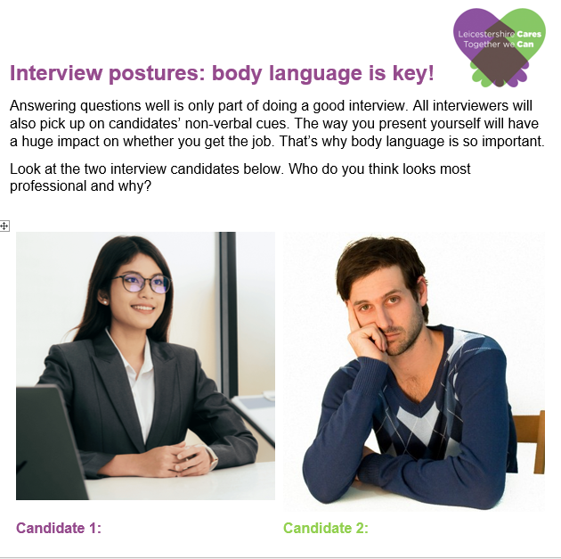
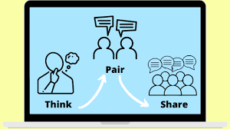


What can you remember from WOW?
Think – Pair – Share
What is each candidate communicating through their body language, gesture and facial expression?

Slide 3
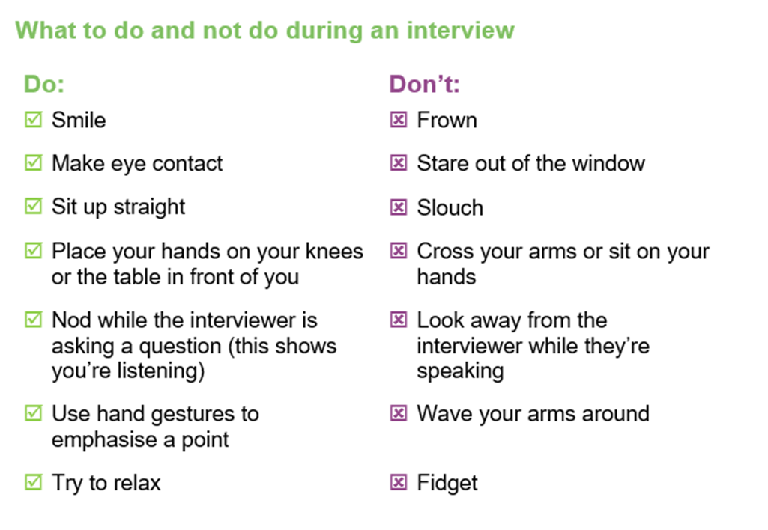


Did your discussion cover any of these?
These are all the nonverbal ways in which we communicate with someone. Remember, up to 93% of what we communicate is communicated non verbally!

Slide 4


With a partner, try out some of these questions;
Tell me about yourself.
Tell me about your skills?
What do you enjoy doing in your spare time?
What kind of person are you?
Why should we give you a job?
What skills would you bring to a college?
How would you describe yourself in 5 words?
What GCSE options did you choose and why?
What was your favourite subject and why?

Slide 5


Mock interview preparation
How well do you work under pressure?
Are you good at meeting deadlines and can you give us an example of a time you responded well to a deadline?
Are you good with time management and can you provide an example of effective time management?
Can you give an example of when you have had to demonstrate good communication skills? Either verbally or in writing.
What qualities do you have as an individual? What would you bring to a team?
Can you give an example of when you have had to demonstrate excellent group work skills?
What did you learn from your time at school in terms of how it could help you in the future?
Which person (either living or dead) do you most admire and why?

