Slide 1
Welcome
New Year 7-Parents’ Evening
3rd July 2024

Slide 2
Aims for this evening
Our expectations and standards
Information about how we care for and organise our students
Communication between home and school
Our school building and its facilities
Uniform
information
Meet key staff

Slide 3
CORE VALUES
ASPIRE
ENJOY
ACHIEVE
Effort
High expectations
High quality curriculum
Respect and relationships
Community
Participation
Excellence
Inclusivity and support
Preparation for life

Slide 4
Key Staff for Year 7 students
Tutor
Associate Head of Year | Mrs Williams
Head of Year | Mr Pankhania
SENDCo | Mrs Loasby
Assistant Principal | Mr Springthorpe
Vice Principal | Mr MacDougall
Associate Principal | Mr Pabari
Principal | Mrs Robinson

Slide 5
Mr Pabari
Associate Principal

Slide 6
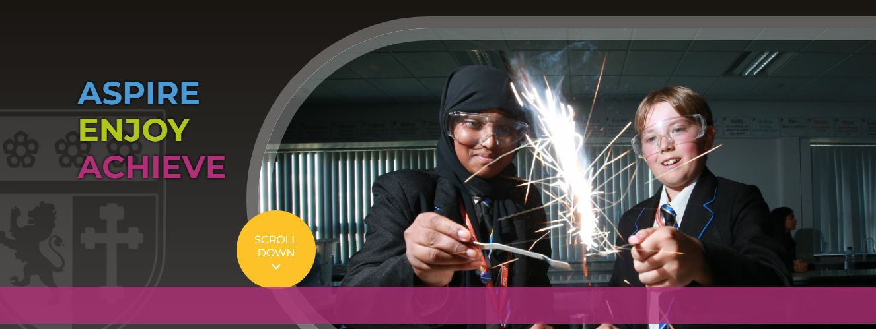
Communication Importance of home-school links and relationships.
Planner
Newsletters
Website
Email
Text
SchoolGateway
Twitter (X) (@soarvalley16)

Slide 7
Rewards

Slide 8
Key dates in the school year
First Day of School
27th August 2024
Year 7 ‘Settling In’ Evening
17th October 2024
Year 7 Parents’ Evening
8th May 2025
Reports (Progress Checks):
PC1: 17th October 2024
PC2: 14th February 2025
PC3: 30th April 2025

Slide 9
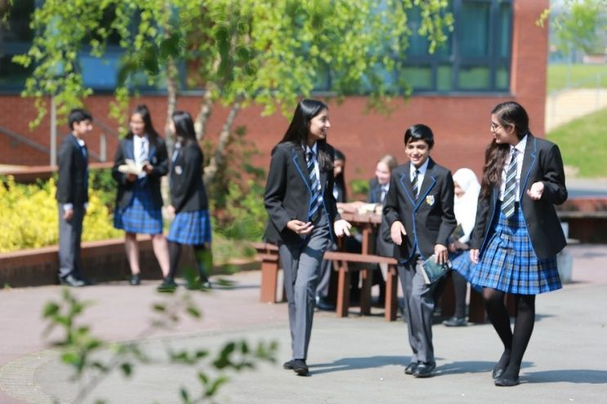
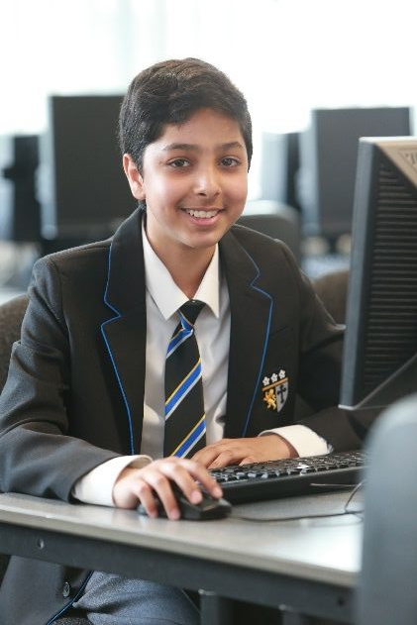
Blazers | Black business cut blazer with blue piping and the school badge purchased from Uniform Direct. Blazers must be worn on school site at all times unless directed by staff.
Trousers | Mid grey tailored school trousers which may be purchased from Uniform Direct. Belts must be plain with no large buckles.
Skirt | The SVC school skirt is available in lengths of 20” 22” 24” purchased from Uniform Direct. Skirts must be worn at an appropriate length and not rolled at the waist. Girls requiring further modesty are able to wear black leggings or SVC grey trousers under the long skirt.
Socks/Tights | Tights must be plain black, natural or grey. If students choose to wear long socks with the school skirt, they must ensure they are worn below the knee, and they must be plain black, white or grey.
Shirt | Plain white shirt (short or long sleeved), tucked in to trousers or skirt with top button buttoned up to take a tie. If students choose to wear a top under the shirt for modesty, this must be plain white.
Tie | SVC clip on school tie purchased from Uniform Direct or the school’s reception.
School jumper (optional) | Mid grey school jumper with royal blue V-neck stripe can be worn in addition to the blazer, not instead of. This is in response to requests from parents and students for additional warmth in the colder months and is available from Uniform Direct.
Footwear | All footwear must be plain, black, practical and smart. Footwear should not have coloured laces, stitching, logos, patterns or contrasting coloured soles. Heels must not exceed 3cm. Plain black ankle boots are acceptable if they adhere to the above. See the SVC website for details of what is appropriate.
Outdoor coats | Outdoor coats should be an addition to and not instead of the school blazer. Hoodies, tracksuit tops or denim coats of any kind are not permitted.
Head coverings | Head coverings for religious reasons must be plain black, white or grey and must be securely fastened.
Bags | It is compulsory to have a school bag. The bag must be large enough to carry A4 books or folders.
Lanyards | Lanyards must be worn at all times for safeguarding purposes. The name and face should be visible at all times.
Make up/Jewellery/ Hats | No excessive makeup or jewellery is to be worn. Excessively long false nails of any material are not permitted. Excessively long false eyelashes are not to be worn. Earrings should be discreet and must be no bigger than a 2 pence piece (length or diameter). No facial piercings or ear stretchers are allowed other than a small, single discreet nose stud/ring. All jewellery must be removed for PE. Any hair accessories must be small and plain black, white or grey. Hats are not to be worn in the school building.
Hair | No excessive colouring of hair is permitted. Where hair has been coloured, it must be of a natural shade (e.g. not blue, bright red, green, etc.). The school reserves the right to decide on the suitability of any colouring.

Slide 12
PLEASE LABEL EVERYTHING!

Slide 13
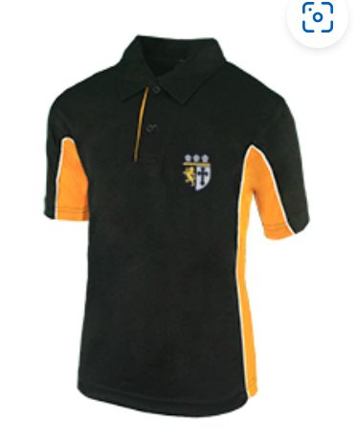
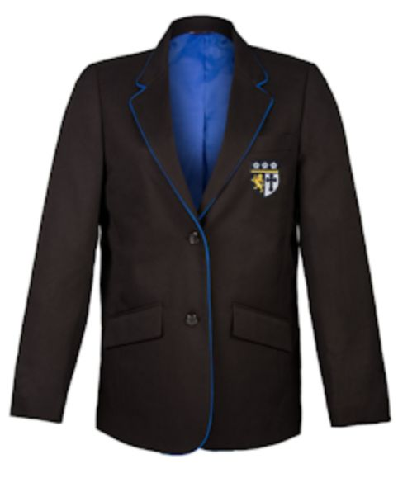
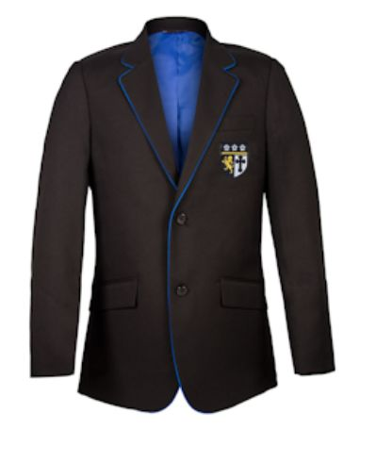
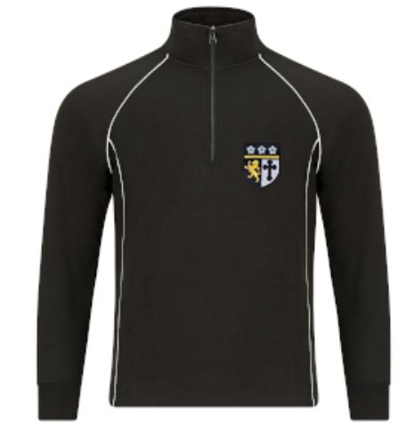
Pre-loved uniform shop
Monday July 8th, from 2.45pm
Donations of £1 per item, donated to charities

Slide 14
Mr Springthorpe
Assistant Principal

Slide 15
It’s not just about today!

Slide 16
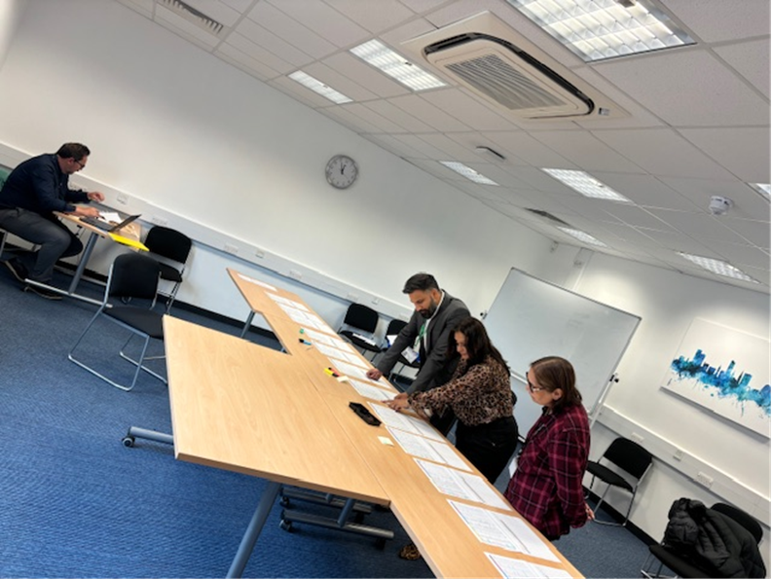
SVC Transition
Primary visits: every student discussed
Tutor Groups
Transition Day – today…
Assembly
Meet the tutor
Share expectations
Team building experience
Made new friends
Found out key pieces of information
Found important places.
At most schools this stops here…...

Slide 17
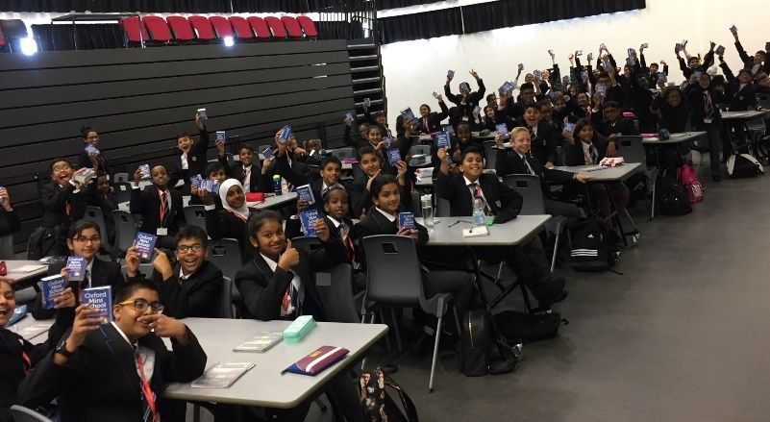
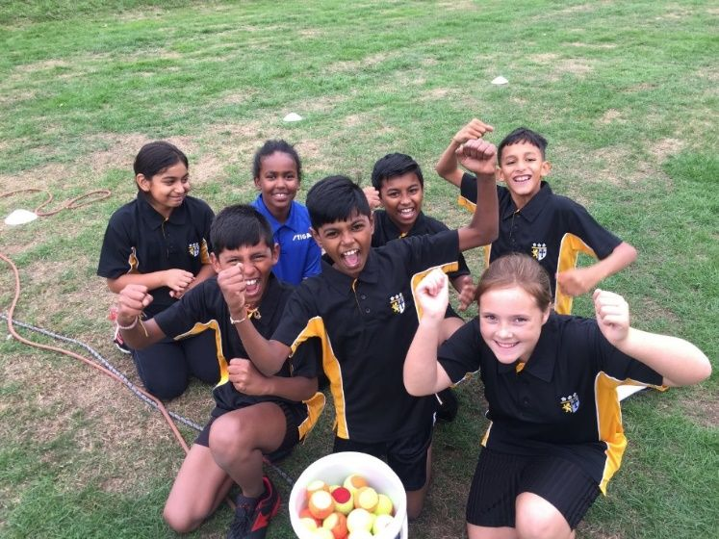
SVC Extended Induction Programme

Slide 18
Mr Pankhania
Head of Year 7

Slide 19
Students’ FAQs about the first day
Where do I go when I arrive?
The Main Hall – Year 7 students should be sat in their seats as the bell sounds at 8:45am
What do I do that day?
Morning with their tutor – expectations / timetables etc.
Lunch
Period 4 & 5 = Timetabled lessons
What do I need?
Full school uniform
School bag
Pencil case (pen/pencil/ruler/rubber/green pen)
How do I get home?
Ensure your son / daughter is aware of how they are getting home.
Is anyone picking them up? Where are they meeting them?

Slide 20
Other common questions
Is my child allowed to bring a mobile phone with them?
Mobile phones are not allowed in school. If students are seen with a phone, it will be confiscated and returned the next day at 3pm.
If you would like your child to bring a phone to school, it can be handed into reception or to Mrs Williams.
What happens if my child is late?
If your child is late to registration they will be given a late detention at break time.
What about lunch arrangements?
Students may bring a packed lunch or have food in school. If eligible for free school meals £2.50 (cost of a meal) will be added to their ID card each day. if not, cards can be topped up on line through School Gateway or in school with cash at the machines.

Slide 21
Tutor Groups
Tutor groups are not based on ability.
Year 7 are taught mainly in their tutor groups but are regrouped in some subjects.
7.1 Mr Oxspring (Hi)
7.2 Mr Neilson (Ge)
7.3 Miss Vindhani (Ma) + Mrs Chandarana (Ma)
7.4 Mrs Cobourne (MFL)
7.5 Mrs Patterson (DT)
7.6 Mr Cherrington (PE) + Miss Briggs (PE)
7.7 Miss Evans (RE)
7.8 Miss Lazar (En) + Mrs MacDougall (En)
7.9 Mr Datta (Art)
7.10 Mr Shuttlewood (IT)
7.11 Mrs Patel (Sc)/Mr Kataria (Sc) + Miss Parveen (Sc)
7.12 Mr Louth (Ma) + Mrs Rathod (Ma)

Slide 22
Mrs Robinson
Principal

Slide 23
Supporting your child through transition
Discuss any concerns and reassure
Go through transition booklet
Look through school website
Remind your child about uniform
Get bags ready before the first morning.
Make sure they are happy with how they are getting home

Slide 24
Uniform, Lockers and Cashless Catering
After this meeting you have an opportunity to;
View uniform
Talk to IT staff about any issues with SchoolGateway
If you wish, your son/daughter may take you for a quick walk around their new school.

Slide 25
Any questions?
Please see a member of staff who will be willing to answer any of your questions.
Thank you and welcome to Soar Valley!

