Slide 1
Where are you going? How are you getting there?
Options 2022

Slide 2

Where are you going? How are you getting there?
12/01/2022
The right courses.
The right attitude.
The right outcome.

Slide 3
 | Date | Details
Assembly | Wednesday 11th January 2022 | Assembly from Ms Newbery about options. Presentation will be shared on Satchel One
Assembly | Thursday 3rd February 2022 | Assembly from Ms Newbery and Mr Cumming about options, with further details about the courses available to students and the EBACC.
Curriculum Booklet | Friday 4th February 2022 | Curriculum Booklet is shared with students
Options Information | Monday 7th February 2022 | ‘Which Way Now?’ booklet shared with students and on Satchel One. This booklet contains reflective tasks about what students strengths are and areas of interest. Tasks will be set each day from Monday-Wednesday
Options Hour and Tutor Period | Wednesday 9th February 2022 | Options Hour: Opportunity to speak to Head of Departments about their subjects. Year 10’s will also be there to support. Activities in the Which Way Now booklet. Booklets will be shared via Satchel One
Option Parents Evening | Thursday 10th February 2022 | Parents have the opportunity to discuss their child’s options with a member of SLT via School Cloud should they wish. This is an optional appointment.
SLT interviews | Week beginning 21st February 2022 | Students have a discussion with a member of SLT about their choices.
Options Deadline | 11th March 2022 | The final deadline for submitting the completed options form to tutors.

Slide 4

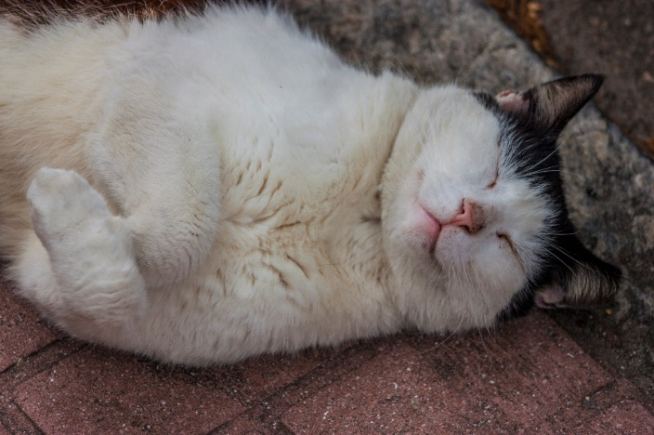

What is the point of school?
To prepare you for your future.

Slide 5


What do you want from your future?

Slide 6

What do you want from your future?

Slide 7

What do you want from your future?

Slide 8



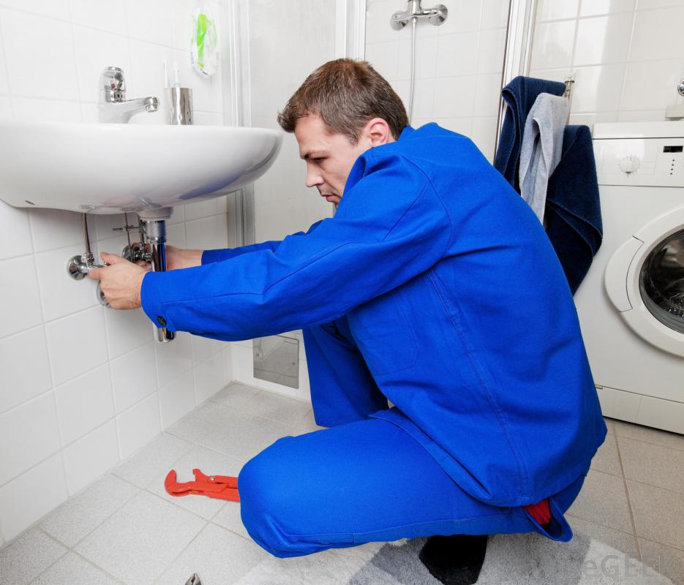


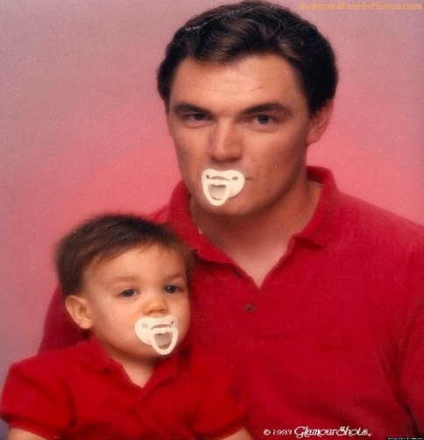

What do you want from your future?

Slide 9
What do I do?!
Give yourself a direction:
How do you like to learn?
What subjects do you enjoy?
What subjects are you good at?
What do others think you’re good at?
What careers might be related to these areas?
What steps do you need to take to get a job in these areas?

Slide 10
What steps do you need to take?
Where are you going?
The correct qualifications are KEY.
How are you getting there?
The correct employability skills are EQUALLY important.

Slide 11
Skills needed for employability that require NO TALENT!
Punctuality – Being on time-don’t be late to lessons!
Working Hard – Effort-put the time into your classwork
Independence – Getting the job done without being asked.
Positive Body Language – Looking like you care and are listening.
Energy – Throwing yourself into your work.
Being positive – Don’t whinge.
Passion – Caring about getting the job done well.
Taking on Feedback – Listening to others and trying to get better.
Doing Extra – Worrying about doing it well, not quickly.
Being Prepared – Having what you need when you need it.

Slide 12

Skills needed for employability that require NO TALENT!
Punctuality
Working Hard
Independence
Positive Body Language
Energy
Being positive
Passion
Taking on Feedback
Doing Extra
Being Prepared

Slide 13
Where are you going? How are you getting there?
12/01/2022
The right courses.
The right attitude.
The right outcome.

